Slide 1
Patient Messaging for Prescription Access & Affordability Issues
Carl Schmid
Executive Director
HIV+Hepatitis Policy Institute
May 16, 2022
Notes:
CARL

Slide 2
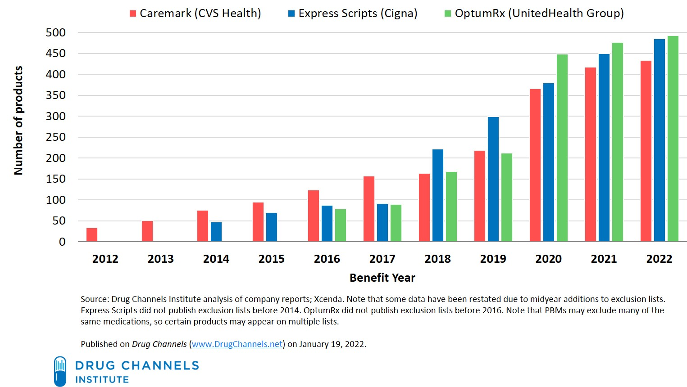
PBM Drug Exclusions

Slide 3
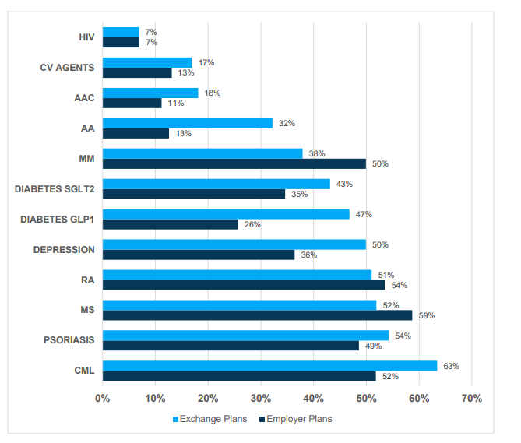
Employer and Exchange Plans’ Use of UM for Single-Source Brand Drugs, by TA, 2020
https://avalere.com/wp-content/uploads/2021/11/UM-Trends-in-the-Commercial-Market.pdf

Slide 4
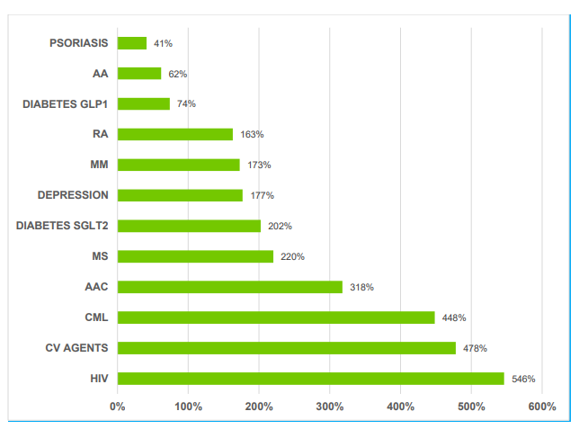
Change in ST for Single-Source Brand Drugs in the Commercial Market by TA, 2014-2020

Slide 5
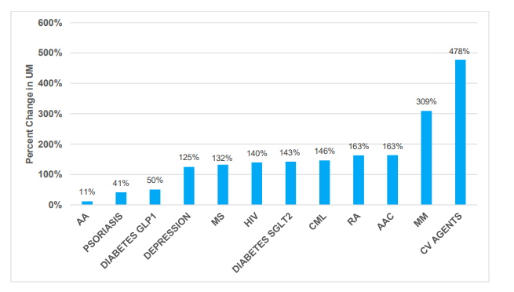
Change in Use of UM for Single-Source Brand Drugs in the Commercial Market by TA, 2014-2020

Slide 6
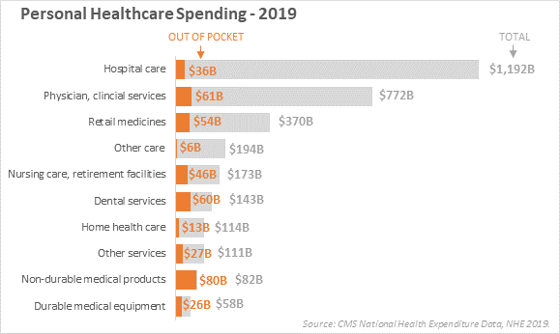
Personal Healthcare Spending – 2019
3%
7.8%
14.5%
Notes:
CARL

Slide 7
Increasing Deductibles
Median QHP Deductibles – Silver Level
$4,375
The PY22 silver plan median deductible is $5,155, which is an increase of 6% from PY21 and 23% from PY18.
Source: https://www.cms.gov/CCIIO/Resources/Data-Resources/Downloads/2022QHPPremiumsChoiceReport.pdf

Slide 8
Patient Affordability Study
About a third (32%) of single-person households with private insurance in 2019 could not pay a $2,000 bill, and half (51%) could not pay a $6,000 bill.
Over 40% of multi-person households can't cover a mid-range employer family plan deductible of $4,000, and 61% don't have enough to cover a high-range deductible.
With an average out-of-pocket maximum for single coverage of $4,272 in 2021 the study concludes: “Most households do not have enough liquid assets to meet the typical out-of-pocket maximum.”
Gregory Young, Matthew Rae, Gary Claxton, Emma Wager, and Krutika Amin, Peterson-KFF Health System Tracker (Mar. 10, 2022), https://www.healthsystemtracker.org/brief/many-households-do-not-have-enough-money-to-pay-cost-sharing-in-typical-private-health-plans/
Notes:
CARL

Slide 9
Silver Plans: Copay vs Coinsurance
(FFE & CA 2022)
Preferred:
67% of plans use copayments (Average $99)
33% of plans use coinsurance (Average 37%)
Non-preferred:
24% of plans use copayments (Average $159)
76% of plans use coinsurance (Average 45%)
Specialty:
7% of plans use copayments (Average $493)
93% of plans use coinsurance (Average 44%)
Source: Avalere PlanScape®, a proprietary analysis of exchange plan features, December 2021.
Notes:
CARL

Slide 11
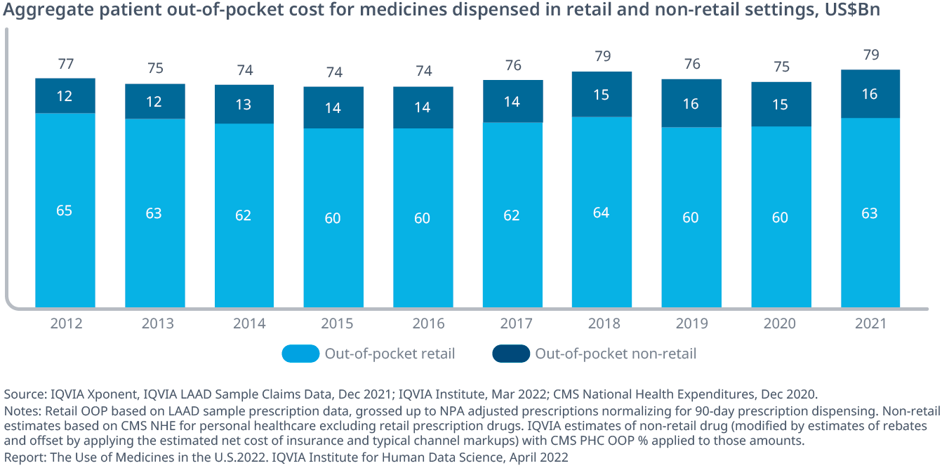
Patient Cost-Sharing for Drugs
Notes:
CARL

Slide 12
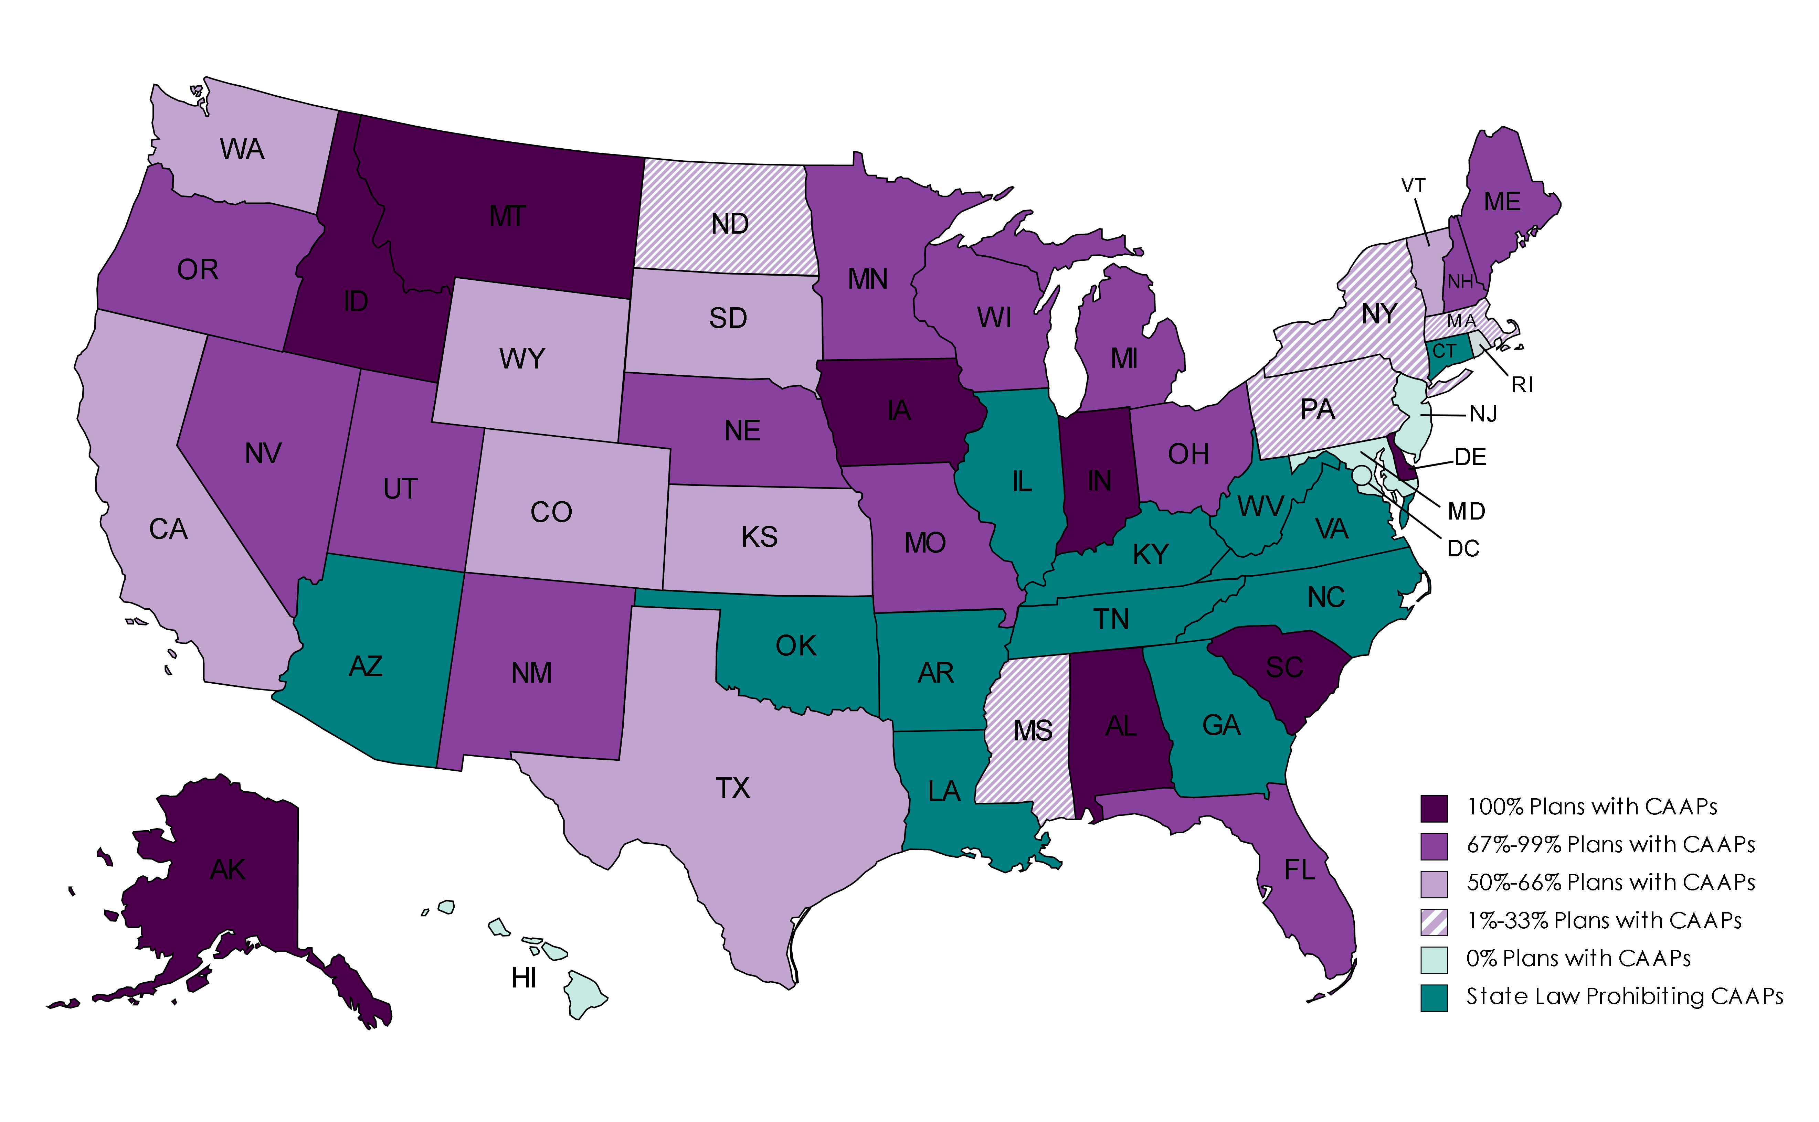
National Overview
Percent of Plans in States with Copay Accumulator Policies

Slide 13
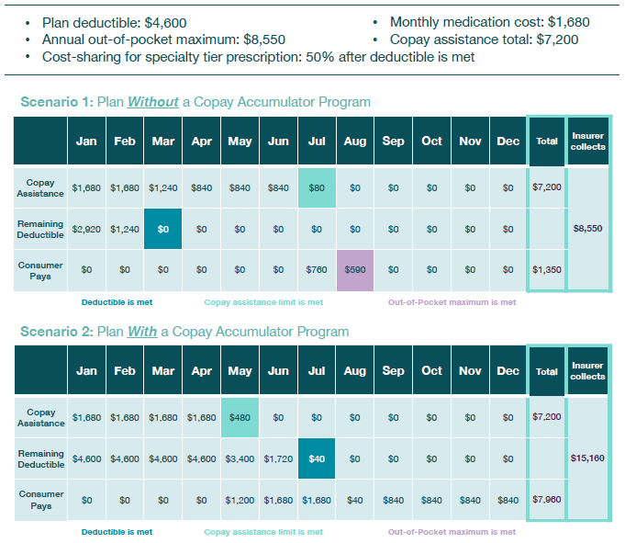
Patient Scenarios

Slide 14
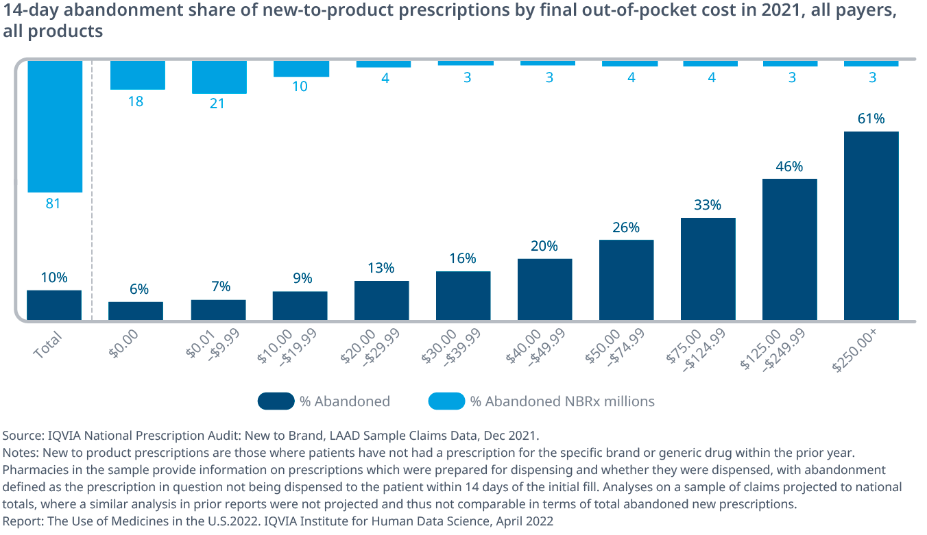
Cost-Sharing and Rx Abandonment
Notes:
CARL

Slide 15
Role of Copay Assistance
Sources:
IQVIA National Prescription Audit, Formulary Impact Analyzer, Jan 2019.
IQVIA Xponent, IQVIA LAAD Sample Claims Data, Dec 2021; IQVIA Institute, Mar 2022; CMS National Health Expenditures, Dec 2020.
Reports:
Medicine Use and Spending in the U.S. – A Review of 2018 and Outlook to 2003. IQVIA, May 2019.
Medicine Spending and Affordability in the United States – Understanding Patients’ Costs for Medicines. IQVIA, August 2020.
The Use of Medicines in the U.S. – Spending and Usage Trends and Outlook to 2025. IQVIA, May 2021.
The Use of Medicines in the U.S. 2022 – Usage and Spending Trends and Outlook to 2026. IQVIA, April 2022.
Notes:
CARL

Slide 16
Thank you!
Carl Schmid
Executive Director
HIV + Hepatitis Policy Institute
cschmid@hivhep.org
Follow: @HIVHep

