Slide 1
The Role & Impact of the CDC & its Grantees in
Ending HIV in the U.S.
Whitman-Walker Health: Safeguarding Public Health
Juan Carlos Loubriel (He/Him/Él)
Senior Director of Community Health and Wellness

Slide 2
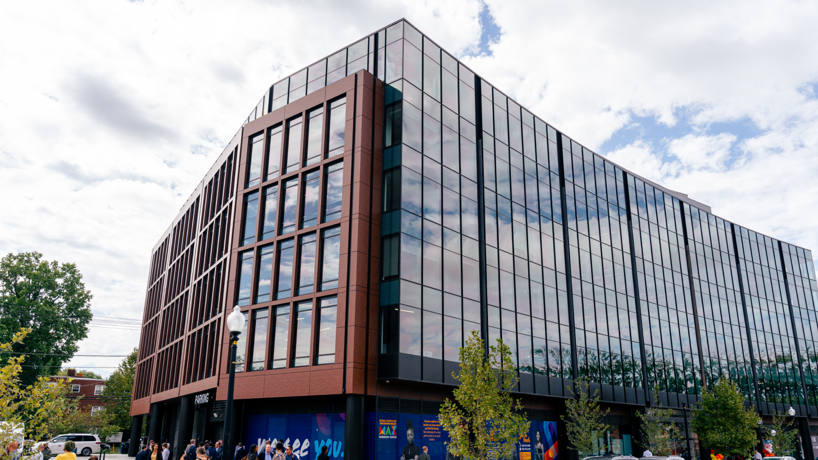
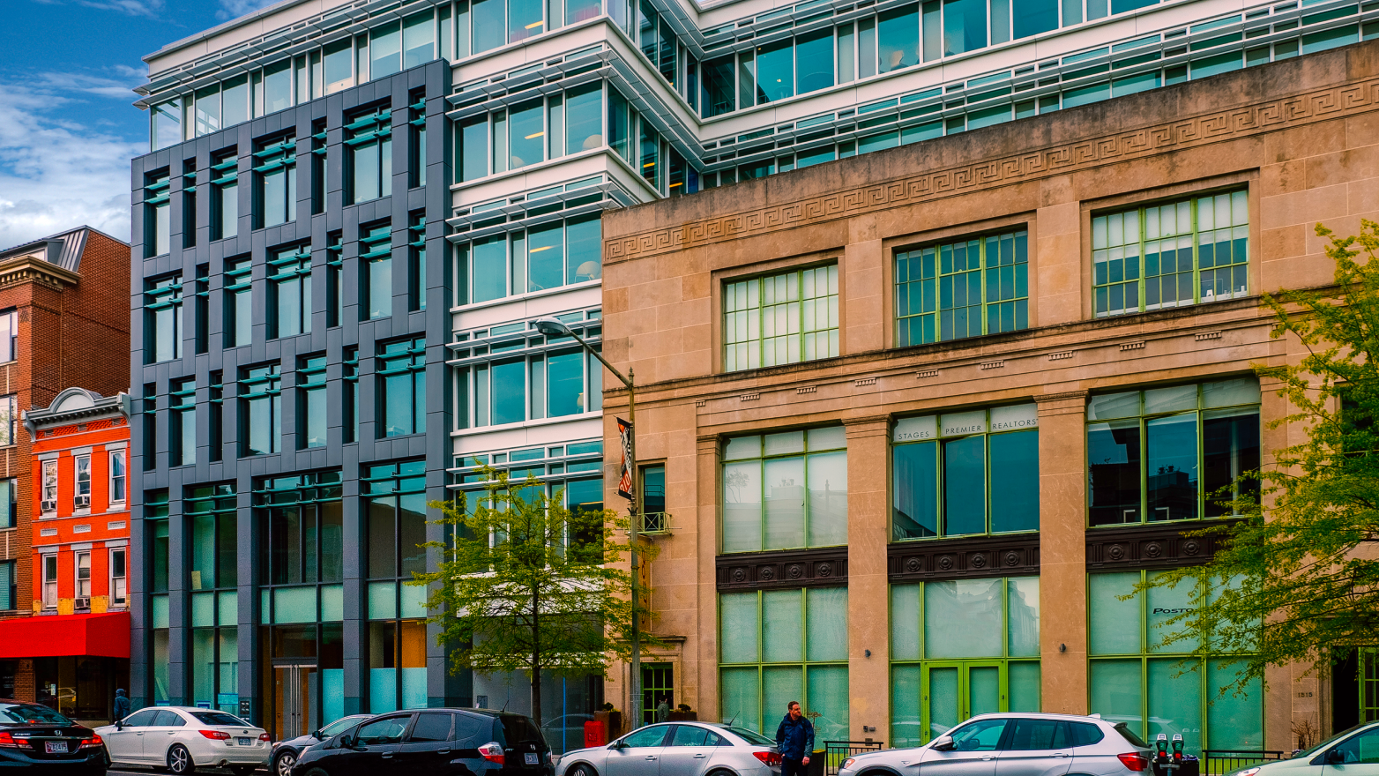
Whitman-Walker Health
OUR VISION
OUR MISSION
Whitman-Walker Health (WWH) envisions a society where all individuals are seen for who they are, treated with dignity and respect, and afforded equal opportunity to health and well-being. Through care, advocacy, research and education, we empower all persons to live healthy, love openly, and achieve equality and inclusion.
Whitman-Walker Health offers affirming community-based health and wellness services to all with a special expertise in LGBTQ and HIV care. We empower all persons to live healthy, love openly, and achieve equality and inclusion.
Whitman-Walker at LIZ
Max Robinson Center
Whitman-Walker at 1525

Slide 3
Notes:
Four Pillars Diagnose, Treat, Prevent, and Repond

Slide 4
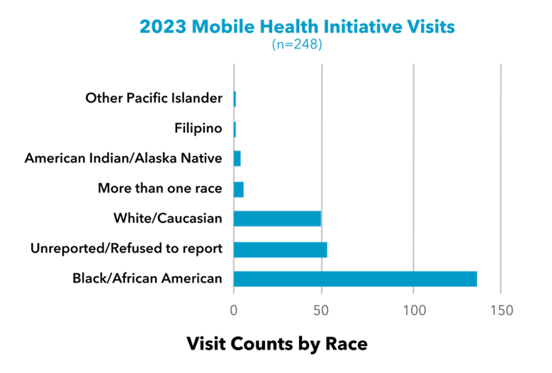
Public Health Impact from CDC funding
DIAGNOSE
Integrated HIV/STI Testing & Treatment
Confidential HIV and STI testing is offered to the general public age 13+ at WWH's two health centers.
WWH’s Mobile Health Initiative
Community-based program to increase engagement and expand access to care in Wards 5-8.
Free consultation with a WWH provider, blood pressure reading, HIV and STI testing screening and treatment, nPEP and rapid PrEP Start, and linkage to care.
Strengthening Community Partnerships
School-based Screening Program – Provided Testing education to 98 students.
SMYAL, Howard University, Horton’s Kids, Delta Sigma Theta Sorority.

Slide 5
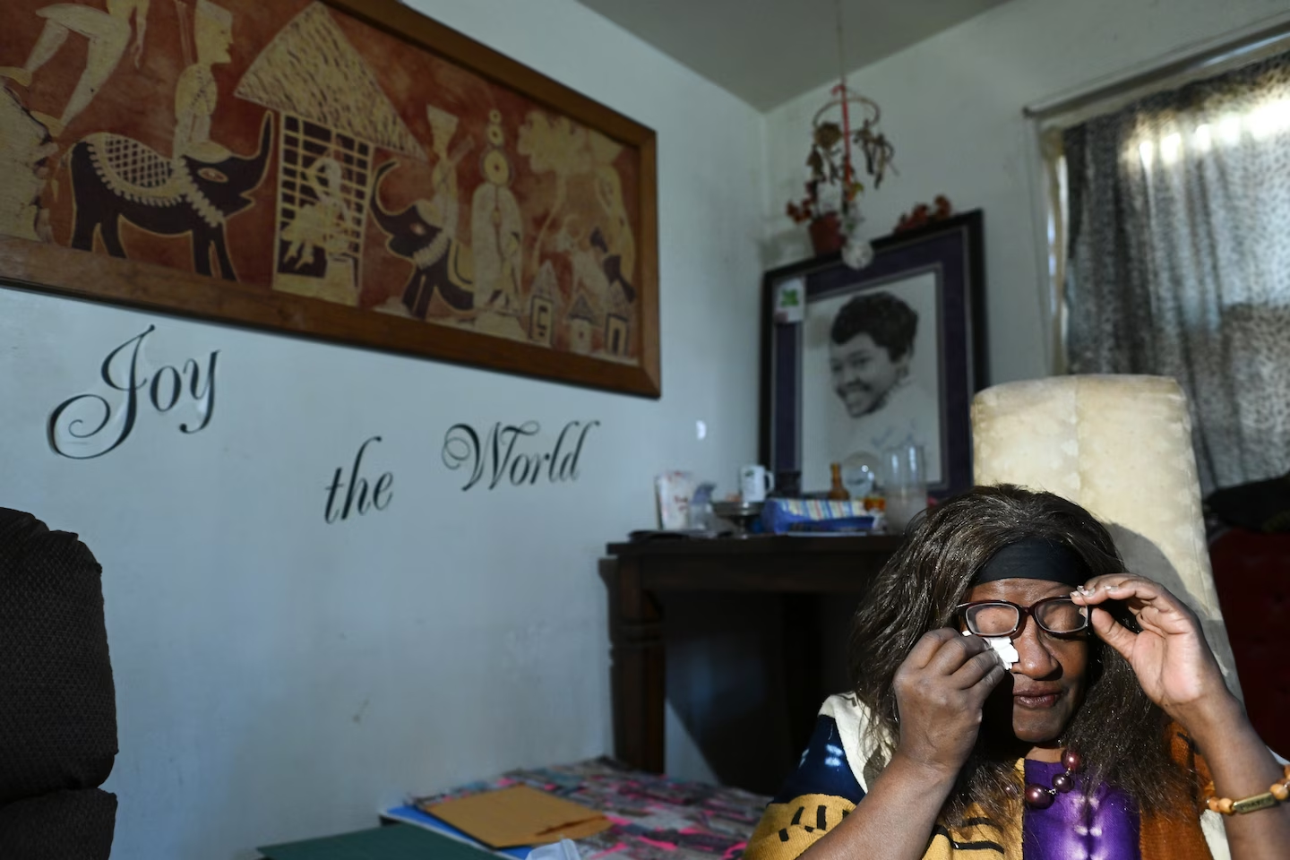
Public Health Impact from CDC funding
TREAT
Linkage to HIV Medical Care
Linking persons newly diagnosed with HIV (identified through CDC-funded programs) to HIV medical care and ART within 30 days of diagnosis.
Re-Engagement to HIV Medical Care
Re-engaging persons who were previously diagnosed with HIV and not-in-care, who were then (through the CDC targeted treatment program) brought back into HIV medical care within 30 days.
Providing Youth and Family Care Navigation services to pregnant women living with HIV, ensuring they stay engaged in HIV and OB/GYN care for the duration of pregnancy, and re-capturing those previously diagnosed with HIV who have fallen out of care prior to pregnancy.
Half of Black D.C. residents lack easy access to health care, analysis shows
By Michael Brice-Saddler, Jenna Portnoy, John D. Harden & Janice Kai Chen
Christy Webster, 63, wipes a tear away as she discusses her health concerns at her D.C. home. (Matt McClain/The Washington Post)

Slide 6
Public Health Impact from CDC funding
PREVENT
Condom Distribution
Ensuring access to safer sex materials including condoms and lube through CDC funded program.
We provided 16,000 condoms in 2023
nPEP/PrEP Education, linkage and provision
Providing nPEP education and services to individuals after an acute exposure.
Providing education and linkage to PrEP to individuals vulnerable to HIV.
Providing PrEP Navigation Services to individuals prescribed nPEP and PrEP to ensure clients receive medication while also assessing barriers to adherence.

Slide 7
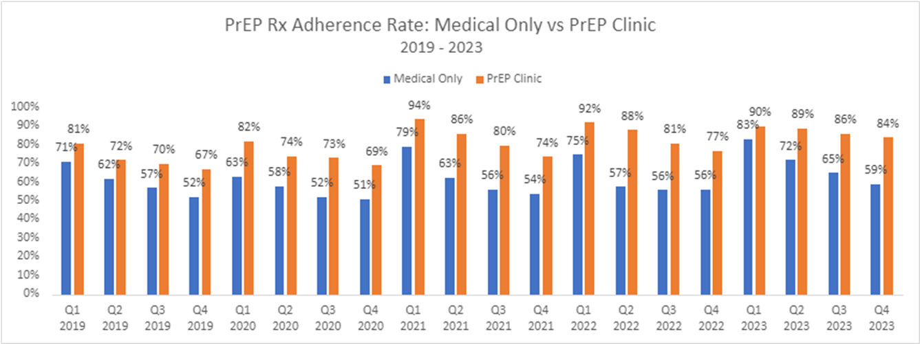
We are increasing access to the newest HIV prevention tools through our specialized PrEP Clinic… ​
Our PrEP Clinic combines follow-up medical and pharmacy visits in one simple stop. Each appointment is approximately 20 minutes long and includes all necessary lab work and dispensing of medication. In 2023, the PrEP Clinic began offering injectable PrEP for eligible patients along with oral PrEP to expand options for prevention.
Injectable PrEP Clinic model operated by community health care workers. This model has been focused on reducing barriers to care by leveraging care navigation and service delivery.
WWH is the third largest provider offering PrEP LAI nationally and is assisting other health centers in developing similar integrated PrEP LAI care models
WWH has started 4,000 patients on PrEP (Nearly half of all PrEP provided in DC)​
2023 PrEP Clinic Appointments:​ 2,761
Novel strategies are needed to reduce PrEP care disparities.

Slide 8
Public Health Impact from CDC funding
Ending the Epidemic (EHE) Wellness Program
EHE Wellness services aim to improve patients’ health outcomes and adherence to HIV prevention and treatment strategies by:
Increasing awareness of HIV status
Increasing timely access to HIV-related care and treatment
Increasing engagement and retention in HIV care
Increasing treatment adherence among people with living HIV
Linking individuals with behavioral vulnerability to HIV to Post-Exposure Prophylaxis (PEP) and Pre-Exposure Prophylaxis (PrEP) to decrease the likelihood of new HIV infection

Slide 9
Whitman-Walker Health serves 21% of DC’s reported HIV+ population through our medical services and 24% through our wraparound services.

Slide 10
Impact of Funding Cuts
Scaling back of prevention programs.
Limited access to testing and treatment.
Reduced education and outreach efforts.
Increased burden on healthcare systems.
Increased social inequities.
Increased health care costs.
Positively Aware – The HIV Treatment Journal of TPAN
A shot prevents HIV, but those most in need struggle to access care
Promise? Making good on the potential of long-acting injectables for Black communities
Even after the pandemic’s uneven toll on people of color focused public attention on health equity, the people in D.C. who would most benefit from this treatment often face greater barriers to accessing it.
By Danielle M. Campbell, MPH, and John W. Meade, Jr., MPH
By Jenna Portnoy
Getting Prepped: RECEIVING long-acting PrEP at Whitman Walker in Washington, D.C. (photo by Jimell Greene)

