Slide 1
The Role & Impact of the CDC & its Grantees in
Ending HIV in the U.S.
Welcome & Introduction
Carl Schmid
Executive Director
HIV+Hepatitis Policy Institute
June 4, 2024
Notes:
CARL

Slide 5
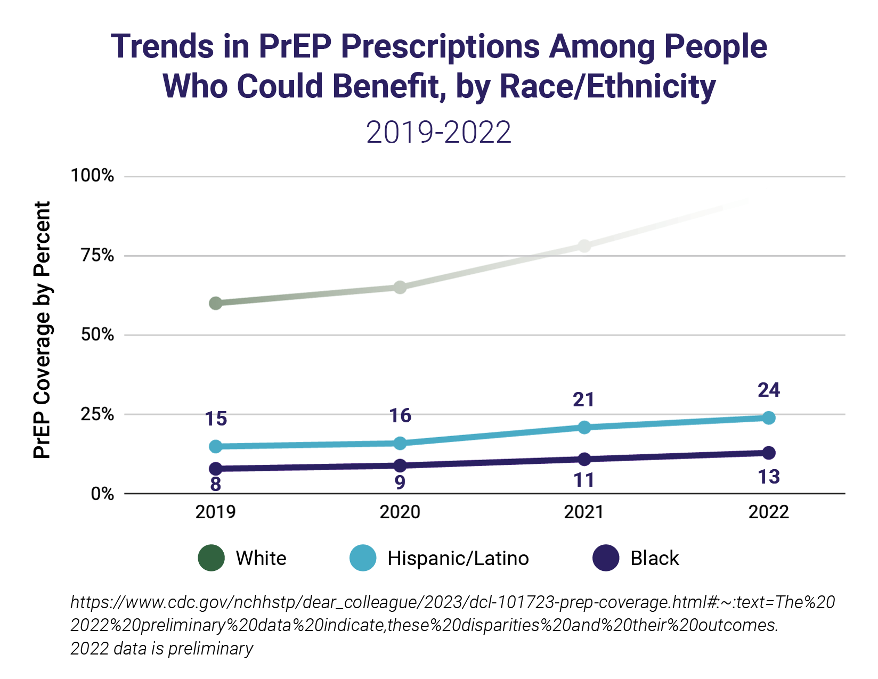

Slide 6
965
987
1014
1014
949

Slide 7
CDC Ending the HIV Epidemic Requested and Enacted Funding
$573M
$375M
$310M
$310M
CDC Enacted
$275M
$140M
$220M
$220M
CDC Requested
$195M
$175M
$140M
Year 1
FY20
Year 4
FY23
Year 2
FY21
Year 5
FY24
Year 3
FY22
Notes:
Over the 4 funded years we have received a total of $370M less than requested

Slide 8
CDC Division of HIV Prevention Funding
 | FY23 | FY24 House Subcommittee | FY24 Senate Committee | FY24 Final | FY25
HIV Prevention | $793.7m (+$2m) | $793.7m (+$0.0m) | $793.7m (+$0.0m) | $793.7m (+$0.0m) | ????
Ending the Epidemic | $220.0m (+$25.0m) | $0.0 (-$220.0m) | $223.0m (+$3.0m) | $220.0m (+$0.0m) | ????

Slide 9
Presenters
Dr. Robyn Neblett Fanfair, Director of Division of HIV Prevention, CDC
Clover Barnes, RN, BSN, MBA, Sr. Deputy Director of the HIV/AIDS, Hepatitis, STD and TB Administration, District of Columbia
Juan Carlos Loubriel, Sr. Director of Community Health and Wellness, Whitman Walker
Notes:
CARL

Slide 10
Thank you!
Presentations: https://hivhep.org/presentations/cdchivbriefing/
Carl Schmid
cschmid@hivhep.org
Emily McCloskey Schreiber
eschreiber@NASTAD.org

